Slide 1
ROM Emulator Capstone Project (Romulator)
By: Nema Karimi
David Landry
Thien Nguyen
Biniyam Yemane-Berhane
Faculty Advisor and sponsor: Professor Arnold Berger

Slide 2
Team and responsibilities
David: Group Leader and Software
Nema: Hardware (PCB)
Thien: Organization and procurement
Biniyam: Hardware (Schematic)

Slide 3

Agenda
What is a ROM?
What is a ROM Emulator?
Why should we emulate ROM?
Computer Interface (Romulator.exe)
Software uploaded to the ROM Emulator
Hardware components

Slide 4
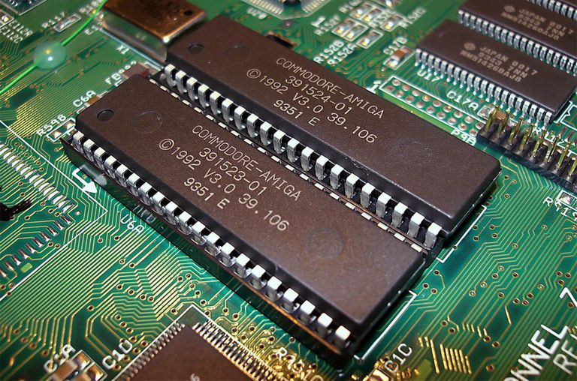
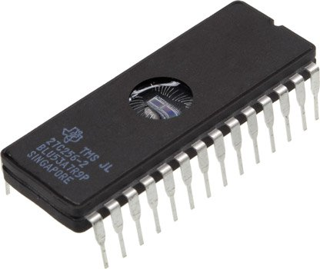
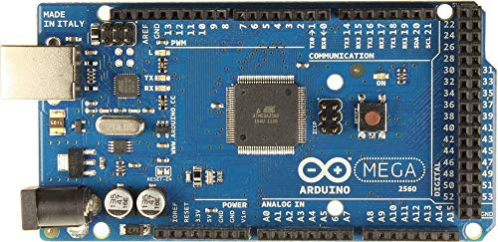
Glossary
ROM: Read Only Memory: Used to store instruction code for computer systems
EPROM: Electrically Programmable Read Only Memory: A ROM type that can be erased using ultraviolet light and reprogrammed
Arduino: A popular single-board computer
RAM: Random-Access Memory can be rewritten to any number of times
the data is known to be addressed by the byte address
Notes:
Rom is a Read only memory used to store instruction code for computer systems
Eprom is electrically programmable read only memory: A ROM type that can be erased using ultraviolet light and reprogrammed
Arduino a popular single-board computer
RAM is a random access memory can be rewritten ti any number of times the data is known to be addressed by the byte address

Slide 5
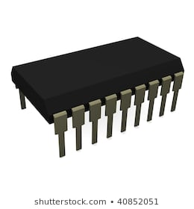
Problem statement
Programming ROM
ROM chips can only be written to once.
Changes to a program to be loaded onto a board
The problem is that ROM can only be written to once, and if there are any mistakes in the program we need a new chip.
What happens of you do not have any spare chips?
EPROM can be rewritten, but needs to be exposed to UV light for 15-20 minutes to erase it.
Notes:
Rom chips can only be written to once
Changed to a program to be loaded onto a board
The problem is that ROM can only be written to once, and if there are any mistakes in the program we need a new chip
EPROM can be rewritten, but needs to be exposed to UV light for 15-20 minutes to erase it

Slide 6

Solution: Use a ROM emulator!
The ROM emulator is an important tool because:
They can rewrite to it as many times as needed
Rewrites only take a few seconds
Saves time and chips
Testing programs becomes much easier, and debugging is simply a matter of uploading a corrected program to the emulator
Notes:
The Rom emulator can rewrite to it as many times as needed
Rewrites only only take a few seconds
Saves time and chips
Testing programs becomes much easier and debugging is simply a matter of uploading a corrected program to the emulator

Slide 7
Design specifications
Here is where you should list what the design parameters are
Emulates ROM-main concern
Timing-Need to be within margins of an actual ROM
Program-Easy and portable:
Works with S-record or Intel Hex
Simple command line interface
Menu for novice programmers
Physical connection:
24-pin DIP
28-pin DIP
32-Pin DIP
Notes:
Emulates Rom main concern
Timing need to be within margins of actual ROM
Program easy and portable: works with S-record or Intel Hex, Simple command line interface, and menu for novice programmers
Physical connection are 24-pin DIP, 28-pin DIP, and 32-Pin DIP

Slide 8
How it works
This Rom Emulator device would use RAM as its primary memory source which can be written to any number of times
using a ROM emulator, a developer could write a test program to a system under test and modify that program as often as needed without the restraints of not being able to write to ROM easily.
This ROM emulator is known for containing important elements
cabling device will match the system’s target of the Rom devices
Having there to be RAM that is known to be very fast to substitute for the ROM for the given target system
There will be local control processor with their being communication ports to the computer.
Rom emulator is known to have trace memory with flash programming algorithms are known to be available

Slide 9
Software

Slide 10
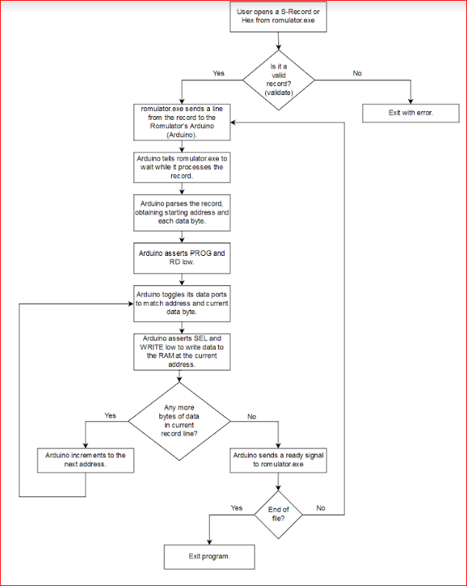
Write Flowchart

Slide 11
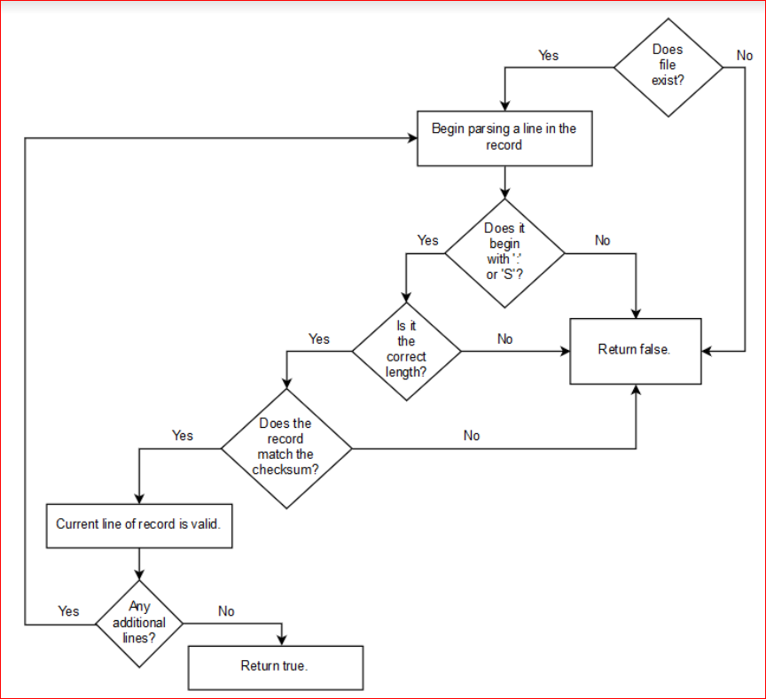
Validate Flowchart

Slide 12
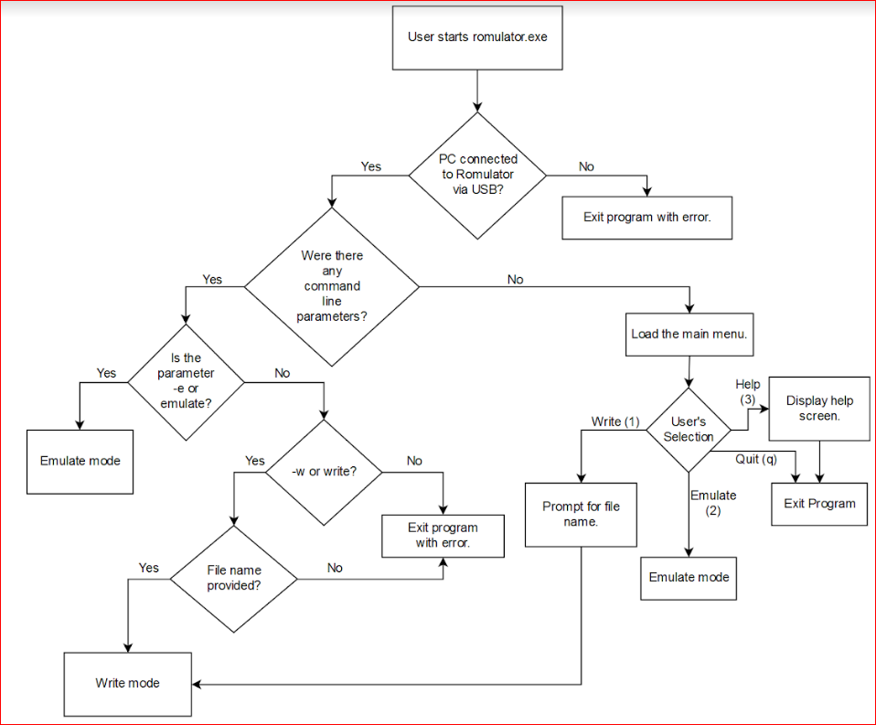
Interface Flowchart

Slide 13
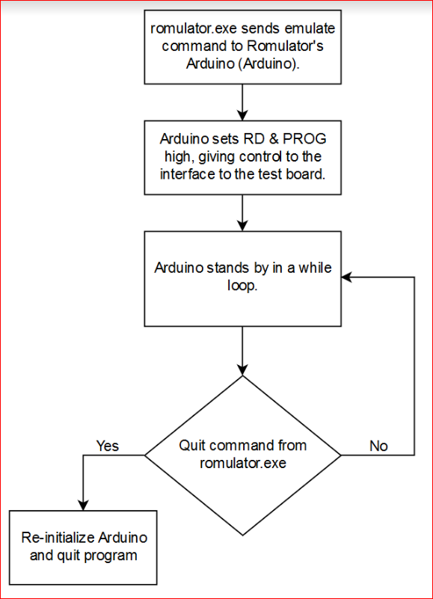
Emulate Flowchart

Slide 14
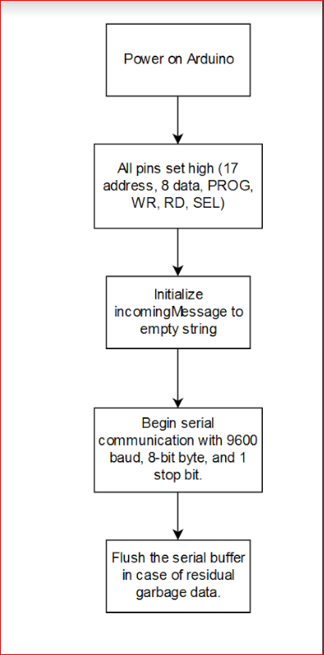
Arduino Initialize

Slide 15
Software specifications-Program to Arduino
Write
Writes data to RAM
Takes in an S-record or Intel Hex and extracts starting address and each byte of data
Writes data to emulator’s RAM (controls ports for write mode)
Verifies data integrity by reading back the date + comparing with data sent to Arduino
Repeat for each record
Emulate
Control ports for emulate mode
Stop if exit command issued

Slide 16
Software Overview
Romulator.exe
Command-line interface
Command line parameters or menu
For windows PC
Supports read, write, emulate, and help commands
Communicates serially with the ROM emulator’s on-board Arduino via USB

Slide 17
Hardware Design

Slide 18
Theory of operation for Rom Emulator-Hardware
This Eprom Emulator project we are using an Arduino Mega 2560, 8 tri-state buffers, a 256k x 8 RAM, an inverter, and a multiplexer. Basically, we want to dual port the RAM
Let two different systems use it. The host would write files into the Ram using the Arduino controller, and the target would read from the Ram.
Use the tri-state buffers as a valve to control the signal coming to and from the RAM.
generate the address, data and control lines from the Arduino.
The inverters are helping us everywhere we want to invert the signal, and the multiplexers are used to select a signal from many signals

Slide 19
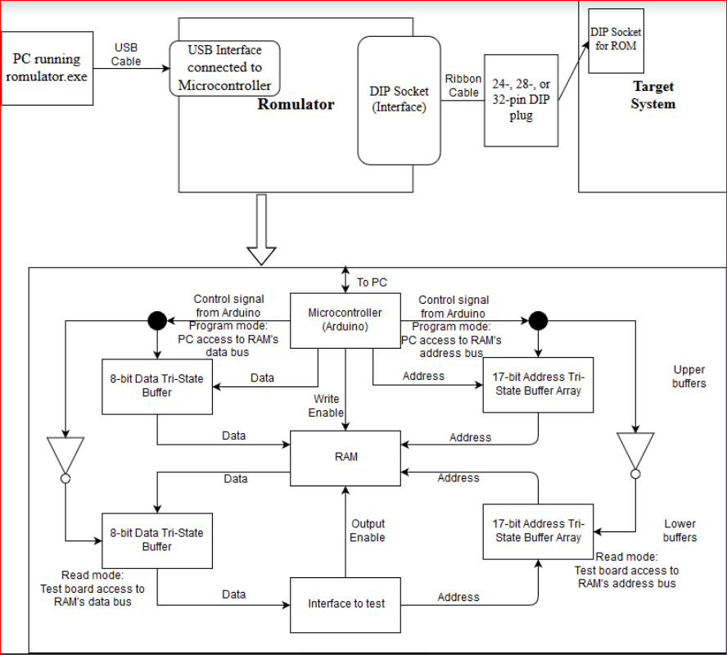
ROM Emulator Block diagram Hardware Overview

Slide 20
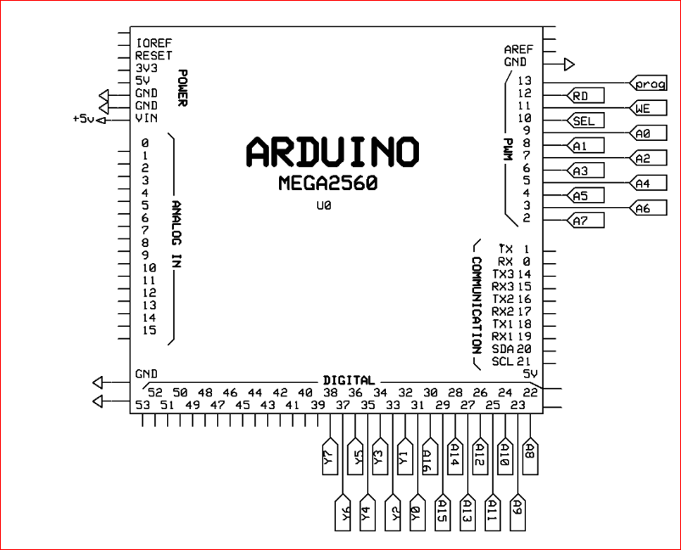
Theory of operation hardware-Control Unit Overview (Arduino Mega-2560 R3)
Controls who has access to the RAM: the PC connected to the ROM emulator or the test board
Connects to the RAM’s address and data lines to store data to the RAM from the user’s PC.
Connected to a PC via USB via a chassis-mounted USB adapter.
Notes:
For the microcontroller there will be about 54 digital I/O pins (input-output), and about 15 of the pins will be very useful for the PWM outputs.
About 16 analog input pins, 4 UARTs (hardware serial ports), 16Mhz crystal oscillator, USB connection, ICSP header, power jack, and reset button.
These pins are very important and needed to support the microcontroller, we will have to connect this to the computer with the help of a usb cable.
Operating voltage is 5v, input voltage ranges from 6-20v, DC, Current per I/O pin is 20mA, and clock speed of 16Mhz.
The ROM Emulator is controlled by a microcontroller, an Arduino Mega 2560 (or “Arduino” for short). The Arduino has two main purposes. First, it controls who has access to the RAM: the PC connected to the ROM emulator or the test board. Second, it connects to the RAM’s address and data lines to store data to the RAM from the user’s PC. The Arduino is connected to a PC via USB via a chassis-mounted USB adapter.

Slide 21
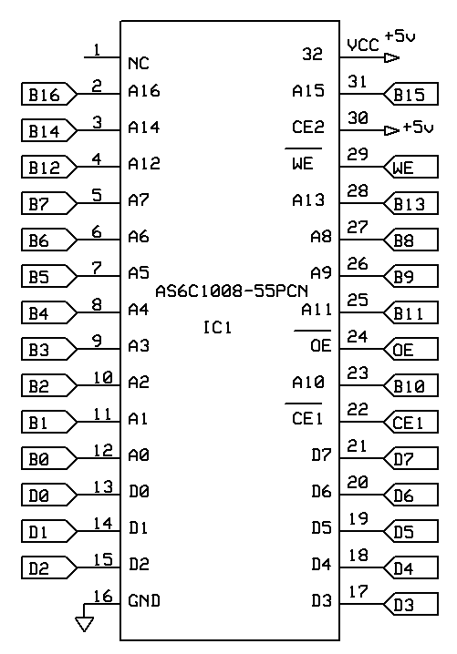
Theory of operation- Hardware components-RAM( AS6C1008-55PCN)
Contains 1MB
17 address-lines
8 data lines
B ports/D ports
Notes:
At the heart of our ROM Emulator is a RAM chip: the AS6C1008-55PCN. This RAM is 1 MB organized as 128k x 8: 128k addresses by 8 data bits. This RAM has 17 address lines (128k = 2¹⁷) and 8 data lines. Address lines connect to either the Arduino or the interface via buffers connected to the “B” ports. Data lines are likewise connected via buffers connected to the “D” ports.

Slide 22
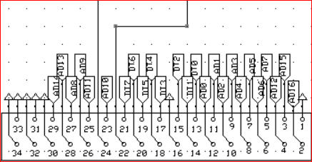
Theory of operation-interface DIP socket
24-, 28-, or 32-pin ROM configuration
Ribbon cables
Interface socket
Emulation mode
Notes:
The interface is a DIP socket and can accept any 24-, 28-, or 32-pin ROM configuration. The interface is connected to the test board via one of 3 included ribbon cables. The DIP plug is aligned with the interface socket from the bottom, since all 24-, 28-, or 32-pin ROM DIPs have the same pin configurations at the bottom end. When the ROM emulator is put into emulation mode, the test board will have read access to the RAM and will regard the ROM emulator as its own ROM chip, executing the program located in the emulator’s RAM.

Slide 23
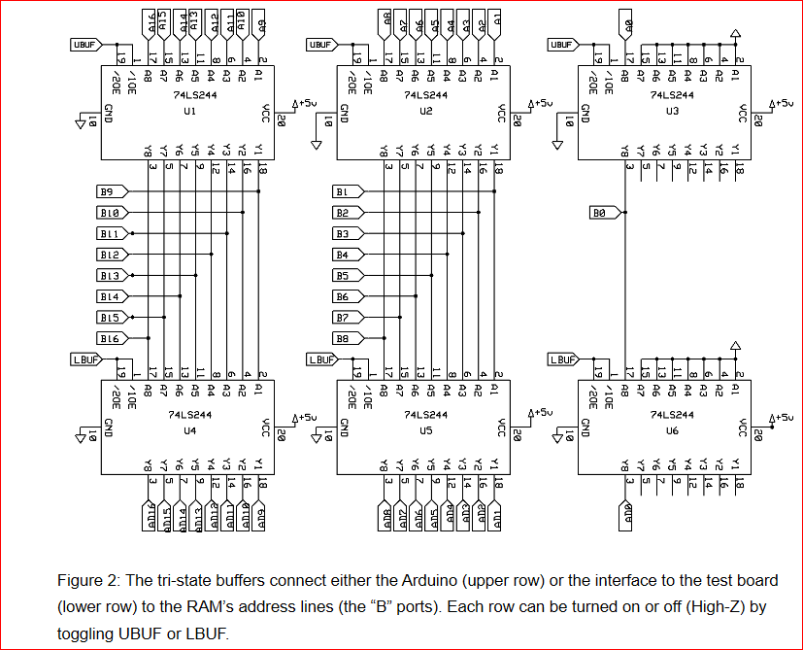
Theory of operation- tri-state buffers (part number 74LS244)
Address lines
Interface
Buffers
Notes:
There are six dual-port tri-state buffers (part number 74LS244) representing the address lines connecting to the RAM. Each of these buffers can accommodate 8 bits, so 3 pairs of buffers are enough to handle 17 address lines (8 bits + 8 bits+1 bit=17 bits for the top and bottom of the address line). The buffers are organized into an upper row and a lower row. The Arduino and the interface to the test board (henceforth referred to as “interface”) both need to access the address of the RAM, so we need a way to control which of the two can be able to access the RAM at any one time. Each row of buffers can be turned on and off by controlling their high-impedance line via the Arduino. The top row will have access to the RAM address lines via Arduino for programming, and the bottom will represent the access of the RAM via the interface for emulation.

Slide 24
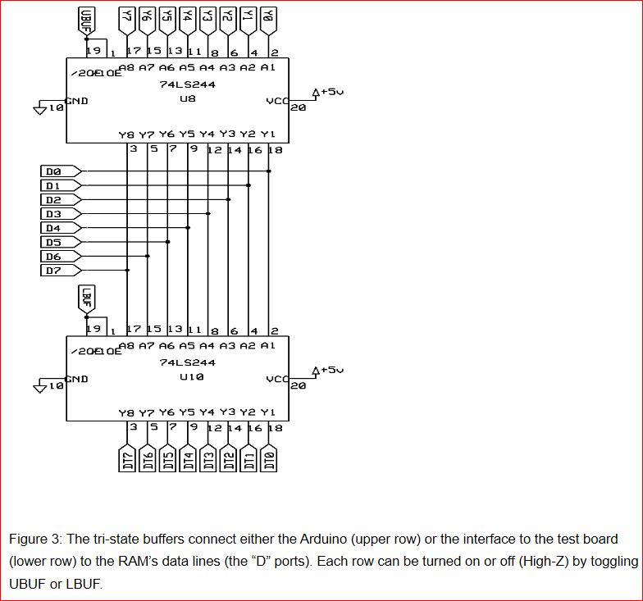
Theory of operation- tri-state buffers (part number 74LS244)
Data lines
Programming RAM
Interface emulation
Notes:
The RAM’s data lines are likewise accessible via buffers. The buffers, like with the address lines, control who can access the RAM: the top row for the Arduino for programming the RAM, or the bottom row for the interface for emulation.

Slide 25
Timing for a Typical Z80 Board
Upstream:
3ns-propagation delay from the test board’s processor to the test board’s DIP socket
1.5ns-Propagation delay across ribbon cable
0.9ns-Propagation delay from the emulator’s interface to the address buffer
20ns-Address buffer switch and hold times
0.6ns-Propagation delay from the address buffer to the emulator’s RAM
55ns-RAM access time
Notes:
RAM(Random Access memory), propagation delay, and buffer switch/hold times, which combined must all be no more than 107 ns.

Slide 26
Verify System can handle Z80 board at max frequency 28MHZ
Downstream:
0.9 ns-Propagation delay from the emulator’s RAM to the data buffer
20 ns-Data buffer switch and hold times
0.6 ns-Propagation delay from the data buffer to the emulator’s interface plug
1.5 ns-Propagation delay across ribbon cable
3 ns-Worst case propagation delay from the test board’s DIP socket to its processor
Notes:
The combined total memory access time for the upstream and downstream is 107 ns.

Slide 27
Hardware Test plan-ROM Emulator test plan
1. Test: Pin Toggle
2. Test: DC Write Test with logic probe
3. Test: DC Read Test with Logic Probe
4. Test: AC Test (jump to self)
5. Test: AC Test Large Scale Program

Slide 28
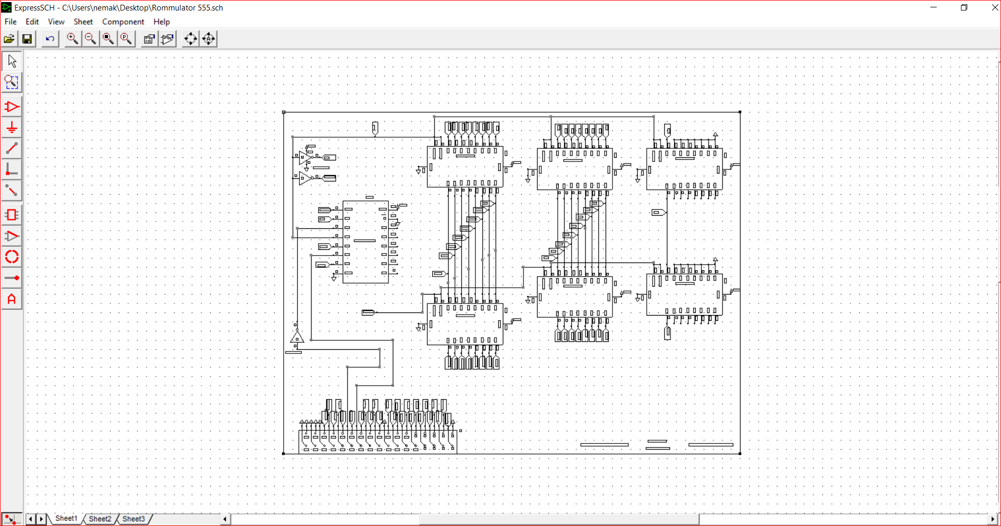
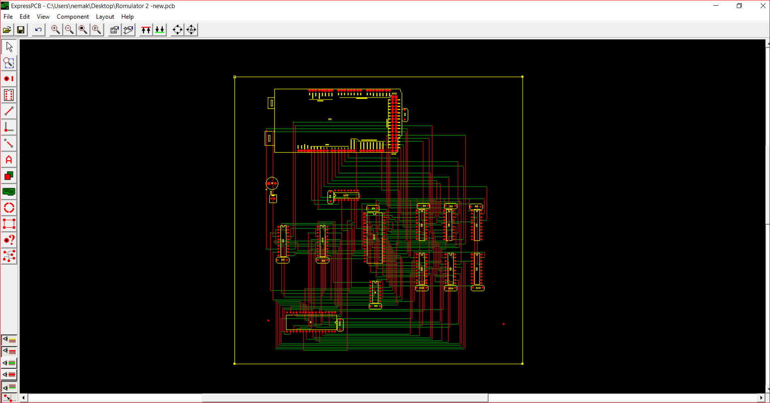
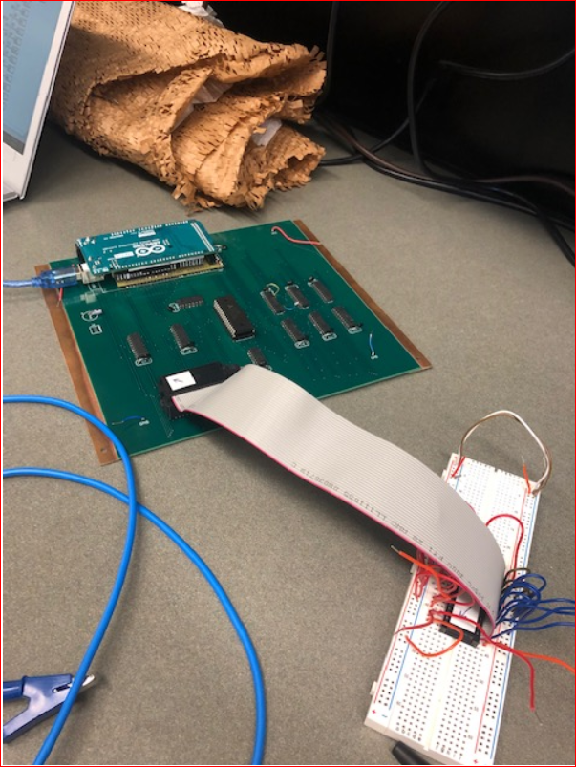
Board Construction
Used Express SCH for schematic and Express PCB for PCB layout
PCB created by Express PCB in 13626 S. Freeman Rd. Mulino, OR 97013
Soldered all parts with soldering iron at UWB beardslee lab

Slide 29
Rom Emulator Project Management

Slide 30


Project Management
First group meeting
There is a chance in finishing in three quarters
Importance of creating a schedule

Slide 31


Research Phase
How we started the Rom Emulator project
What bumps we had along the way
Roadblocks

Slide 32
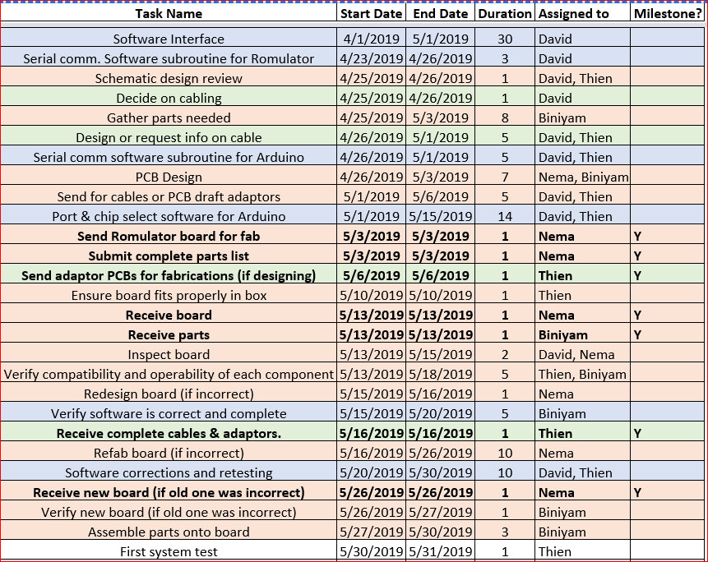
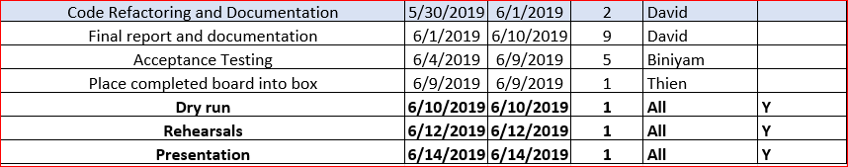
Project management
Schedule Creation
Task determination
Weekly meetings

Slide 33
Conclusion
PCB that does not work due to an error when designing the schematic in express sch.
There was an open discovered because the address buffers in the RAM is aligned differently meaning it is backwards.

Slide 34
Reflections
Why the project was not completed?
A large portion of our failure is that we were not ready for capstone 2 because there was not a complete schematic, and we were still in the designing phase.
In addition, the PCB designing was delayed because of partly not having a working schematic.
A formal design review was never done, so errors in the schematic were not caught.
Eventually, it took a lot of time or our group to get this PCB, which was in the middle of the capstone 2.
there was no given tasks for each group member to do throughout this ROM Emulator project.
Our ROM Emulator group had faced will have to be our availability for the project.

Slide 35
Acknowledgements
Victor Richardson
Arnie Berger
Gytautas Jankauskas

Slide 36

Questions?

